Slide 1
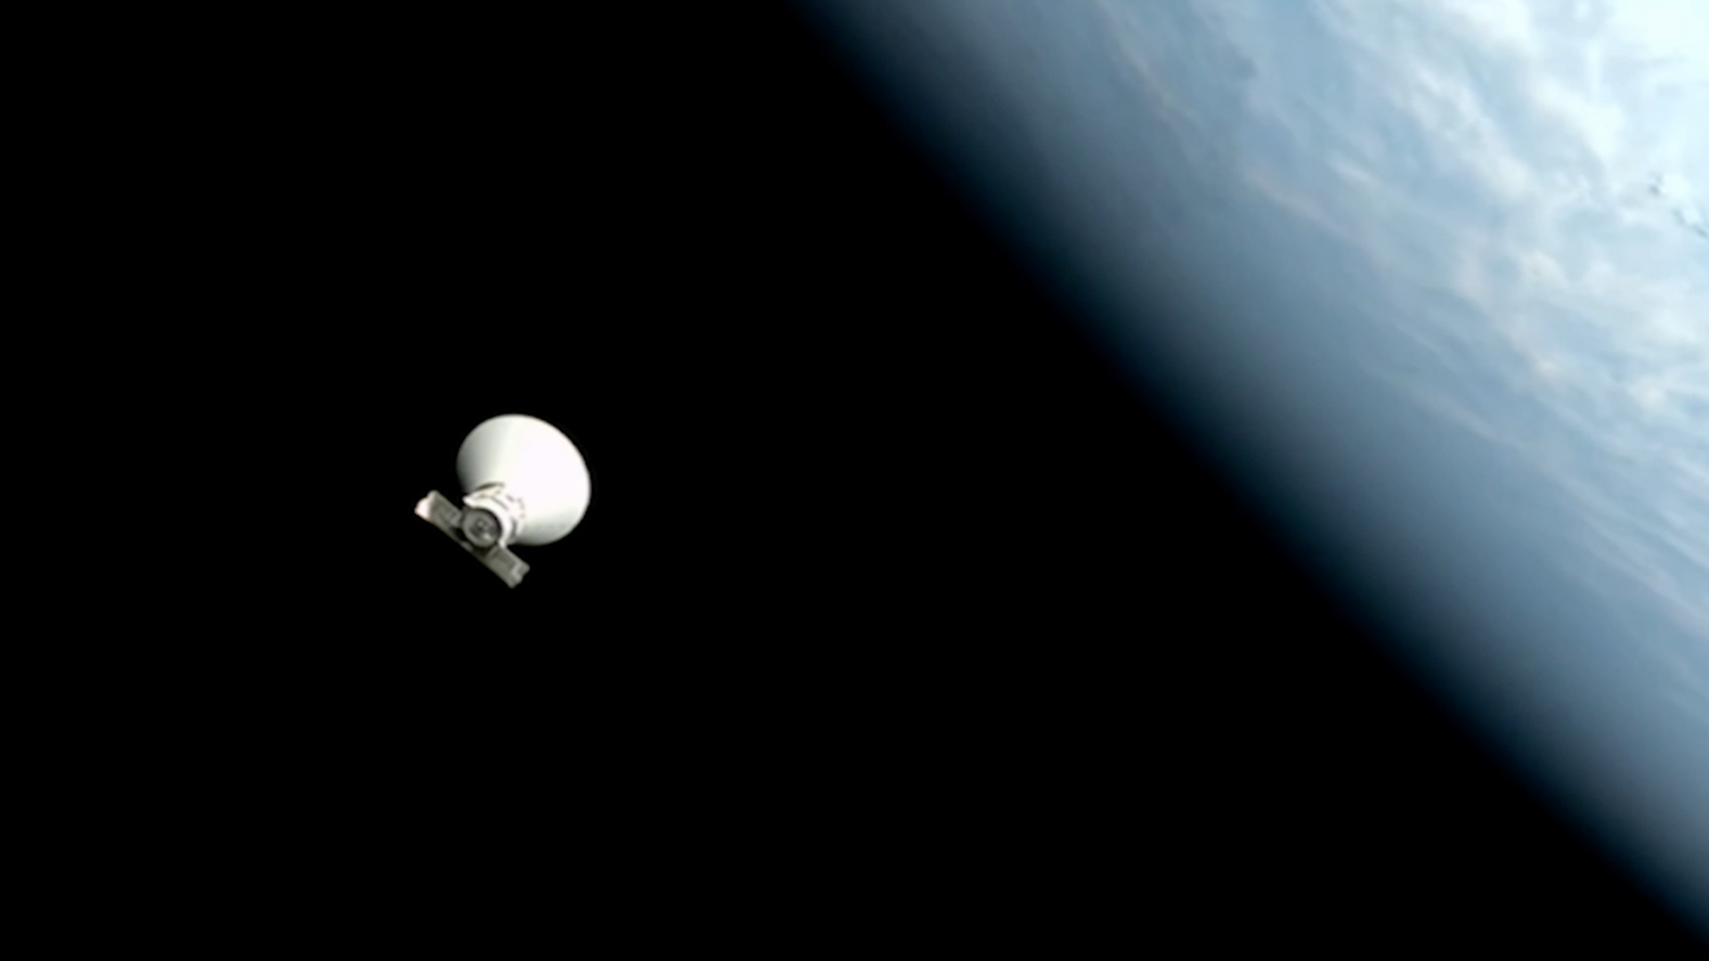
Space Debris Detection

Slide 2
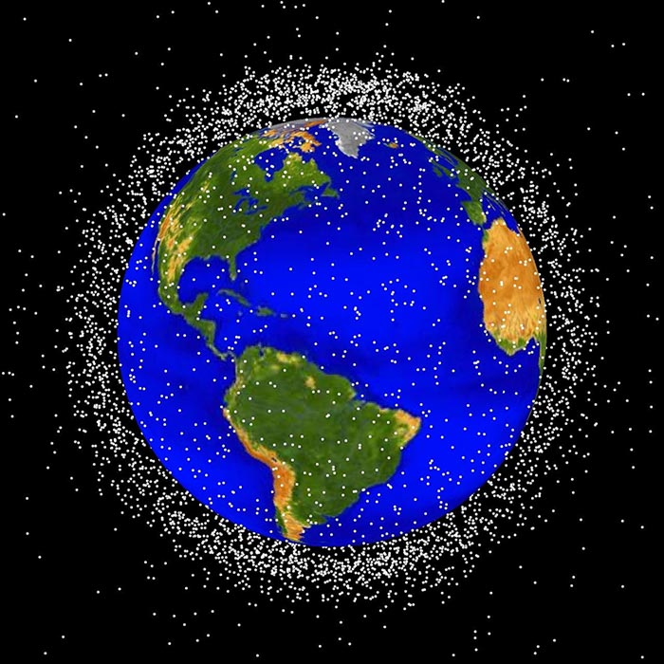
Agenda
Introduction
Overview of Project
Machine Learning Methods Utilized
Technologies Utilized
System Flow & Functionality
Use Cases

Slide 3

Who Am I
Othell Hamilton

Slide 4
Project Overview
The SpaceDebris project implements a Convolutional Neural Network (CNN) using TensorFlow 2.14.1 to process Sentinel-2 satellite imagery, sourced from Google Earth Engine, for detecting space debris. The preprocessed 128x128 RGB images are integrated into a full-stack application with a Flask API and React front-end, enabling real-time debris detection. This project addresses the critical challenge of space debris monitoring, enhancing space situational awareness with applications in satellite safety and orbital sustainability. Its flexible architecture allows pivoting to detect other objects of interest and supports future integration of synthetic or space-specific datasets for improved accuracy.
Convolutional Neural Network (CNN)
A deep neural network designed to process structured grid-like data, such as images or time-series data
Automatically learn spatial hierarchies from raw pixel

Slide 5

Machine Learning Methods Utilized
Enhancing your presentation

Slide 6

Technologies Utilized
Your ability to communicate effectively will leave a lasting impact on your audience
Effectively communicating involves not only delivering a message but also resonating with the experiences, values, and emotions of those listening

Slide 7
System Flow & Functionality

Slide 8

Thank you
Othell Hamilton
940-206-3925
oehamilton@hotmail.com
www.linkedin.com/in/othellhamilton
https://x.com/HamiltonOthell

